Slide 1
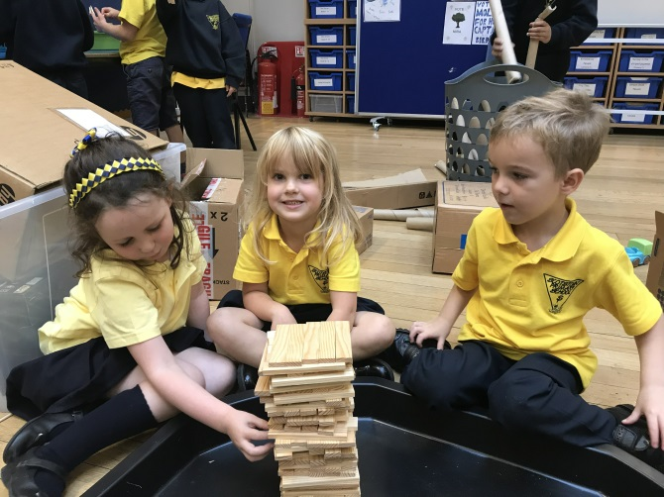
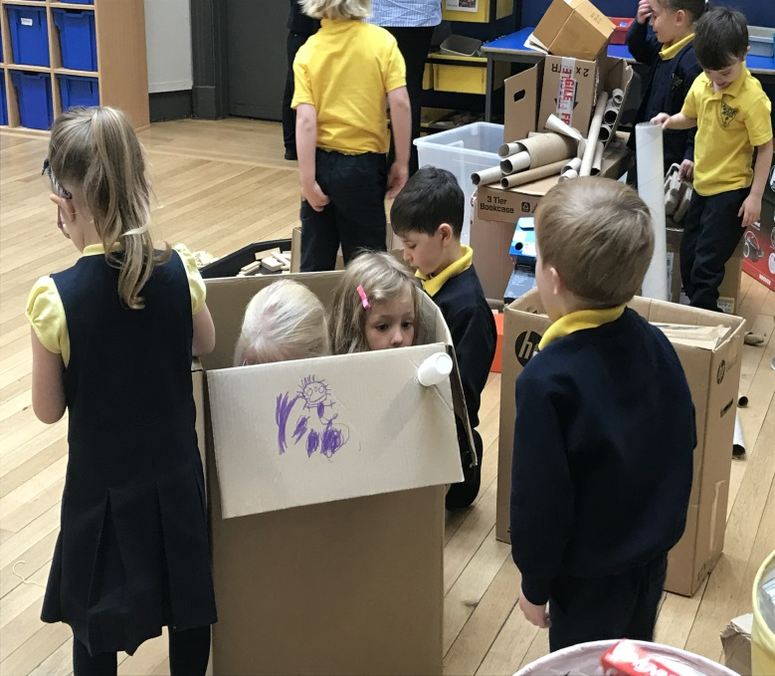
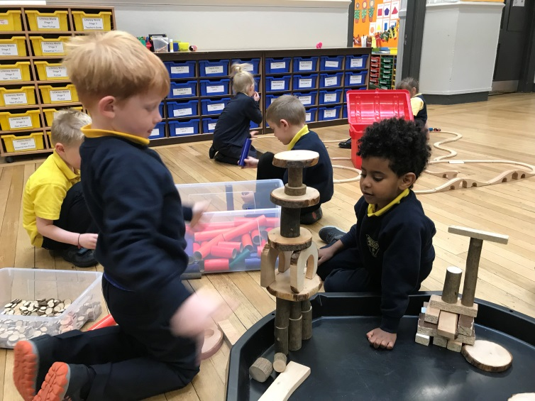
Scotstoun Primary School
Welcome to Primary 1
November 2018

Slide 2
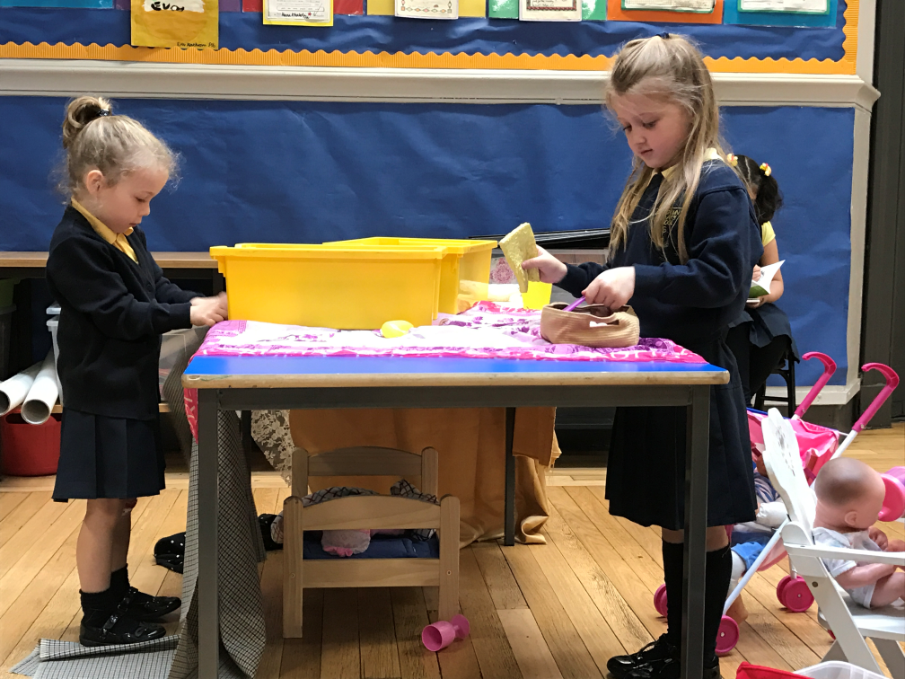
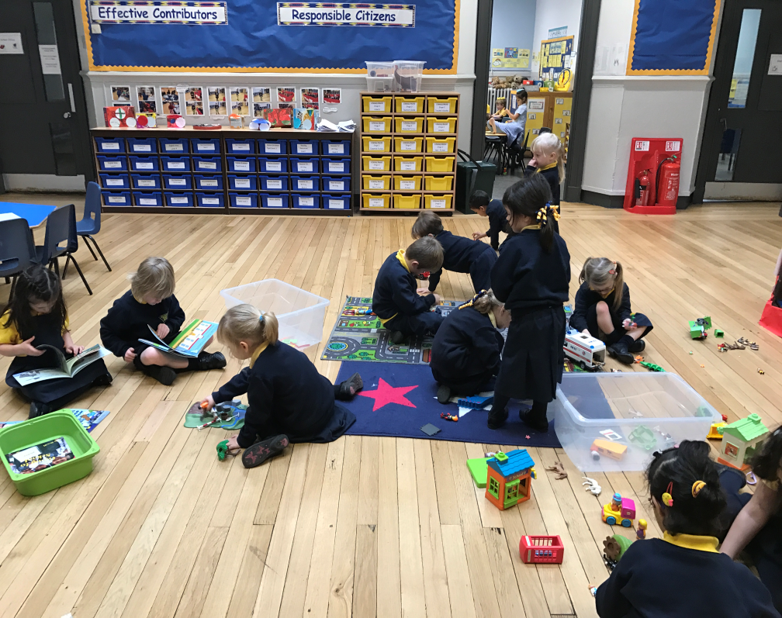
Learning Through Play
Young people in Glasgow are developing learning and achieving through a range of play opportunities.
Playing for Real 2 –
Glasgow’s Play Strategy
2016-2018

Slide 3
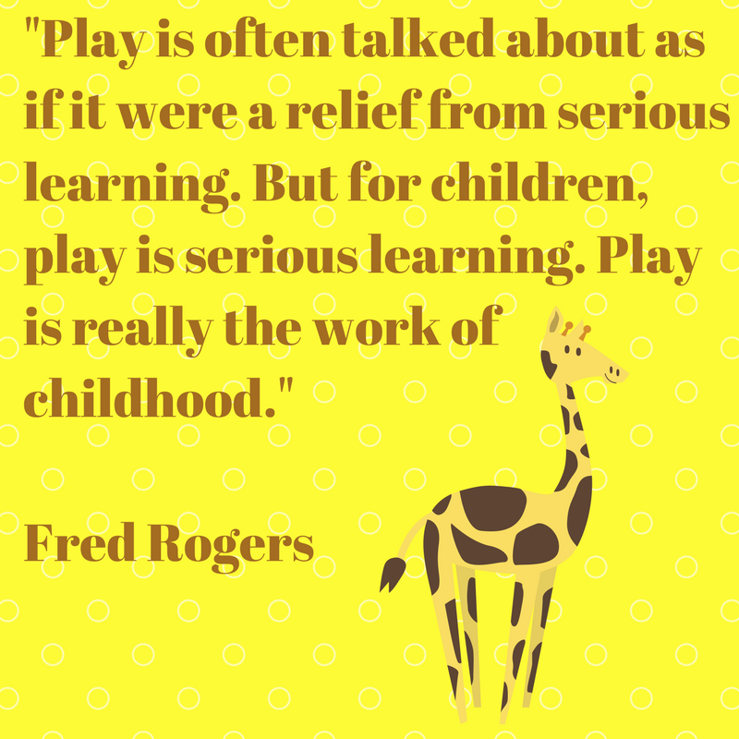
Learning through play is at the heart of our P1 pedagogy.

Slide 4
Literacy
P1 children should not dive into formal literacy but learn through play and creativity ( e.g. stories, song, rhymes, music, visual arts, role play all of which develop the speaking and listening skills upon which literacy is based).
Graeme Logan – Education Scotland / HMI

Slide 5
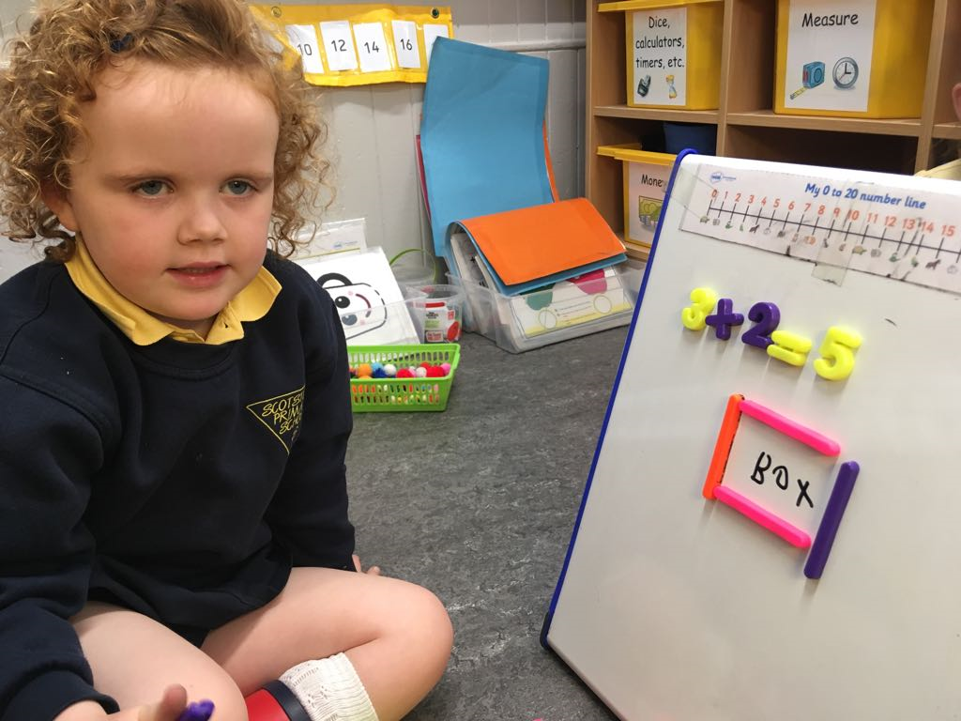
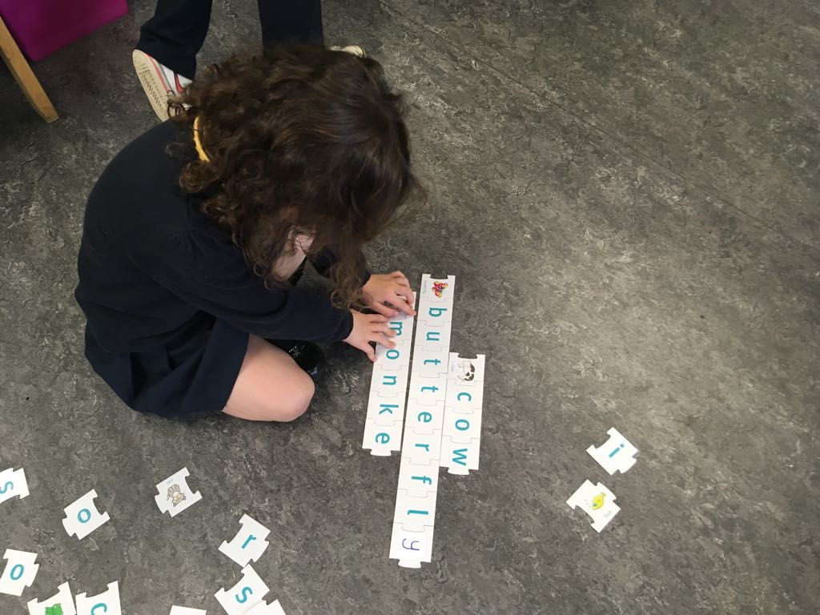
Literacy through Play
This year in Scotstoun Primary we are again embracing learning through play in literacy.

Slide 6
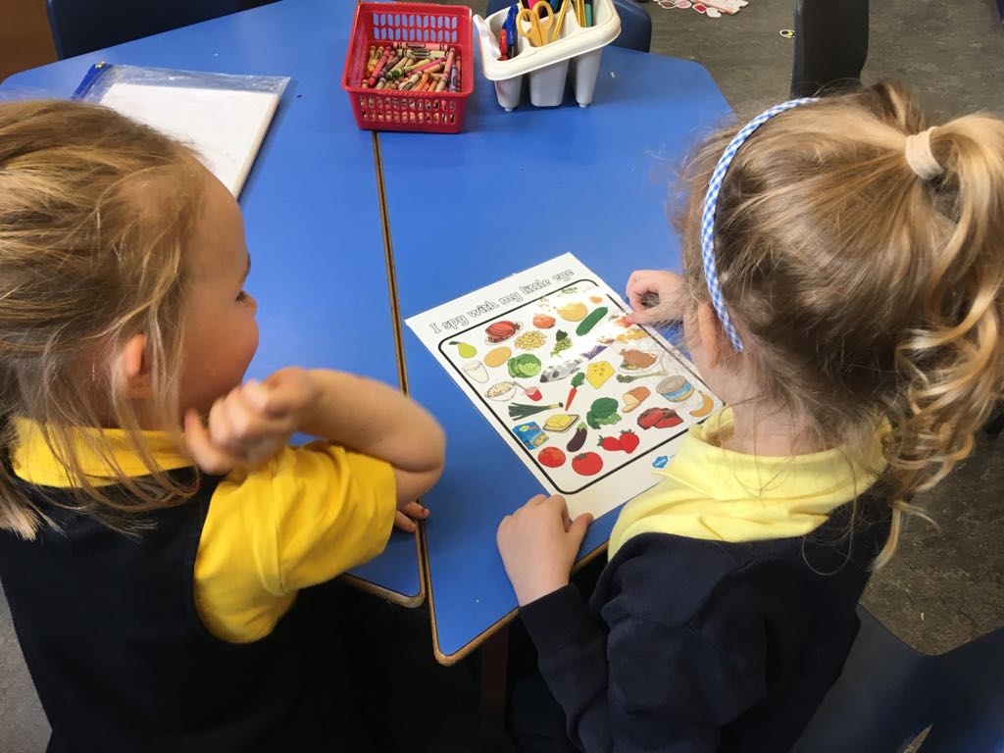

Slide 7
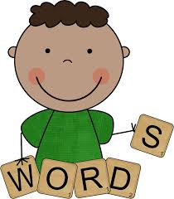
Literacy in P1
The teaching of literacy within a curriculum for excellence is divided into three organisers -
listening and talking
reading
writing
In Primary 1 we spend a large part of our day on literacy skills.

Slide 8
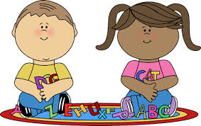
Reading Development
Phonological Awareness – is the ability to listen and discriminate between the various sounds that make up language.
Research indicates there is a correlation between a child’s phonological awareness and reading ability.

Slide 9
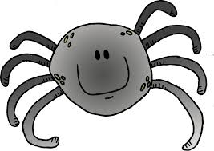
Rhyming
The ability to recognize and produce rhyming words is an important phonological awareness skill.
Our Primary 1 pupils have been developing their rhyming skills through the context of nursery rhymes and through play.

Slide 10
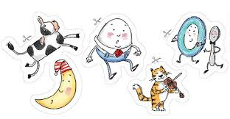
Nursery Rhymes
The children have been introduced to a different nursery rhyme every day.
The children are encouraged to join in with the rhyme.
The children are asked to identify the rhyming words.
The children are asked to give other examples of words that rhyme.

Slide 11
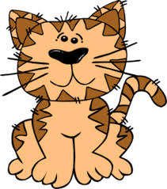

Rhyming homework
Read rhymes with your child and encourage them to join in.
As you read leave out the rhyming word and ask your child what comes next.
Reinforce by saying ‘well done ………….. rhymes with ………….
Play rhyming games – I’m thinking of a word that rhymes with …………..

Slide 12
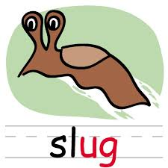

Phonics
Phonics is a method of teaching young children to read and spell.
Children are taught to read and pronounce words by learning to associate letters or letter groups with the sounds they represent.
There are 26 letters in the English alphabet but over 40 speech sounds.

Slide 13
Are you smarter than a 5 year old ?
The Big Phonics Quiz

Slide 14
The Big Phonic Quiz
How many letters or combinations of letters make the long sound o ( as in “toe” ) in English ?
What is a syllable ?
How many syllables are there in the word
pig ?
What is a phoneme ?
How many phonemes are there in the words – cat , chat , fish , stick and blue ?
Identify the consonant blends in the words – fist , slip , shred and prod ?

Slide 15
How well did you do ?
6 ways – “o” as in over , “oa” as in oatmeal , “oe” as in toe , “ow” as in blow , “o” plus a consonant and silent “e” as in bone and “ough” as in though.
A syllable is a word or part of a word that contains one vowel sound.
1
A phoneme is the smallest unit of sound.
Cat = 3 ( c , a , t ) Chat = 3 ( ch , a , t ) Fish = 3 ( f , i , sh ) Stick = 4 ( s , t , i , k ) Blue = 3 ( b , l,
oo )
6. st in fist , sl in slip , shr in shred and pl in plod.

Slide 16
Congratulations

Slide 17
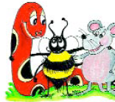
Jolly Phonics
Jolly Phonics is a resource we use in school to teach phonics.
It introduces the children to the letter sounds in an enjoyable way through the use of characters, stories, rhymes and actions.

Slide 18
Learning the letter sounds
In Jolly Phonics the 42 sounds of the English Language are taught.
The sounds are in seven groups with some sounds written with two letters such as ee and or.
The letters are not introduced in alphabetical order. The first group ( s,a,t,i,p,n )have been chosen because they make more simple three letter words than any other six letters.

Slide 19
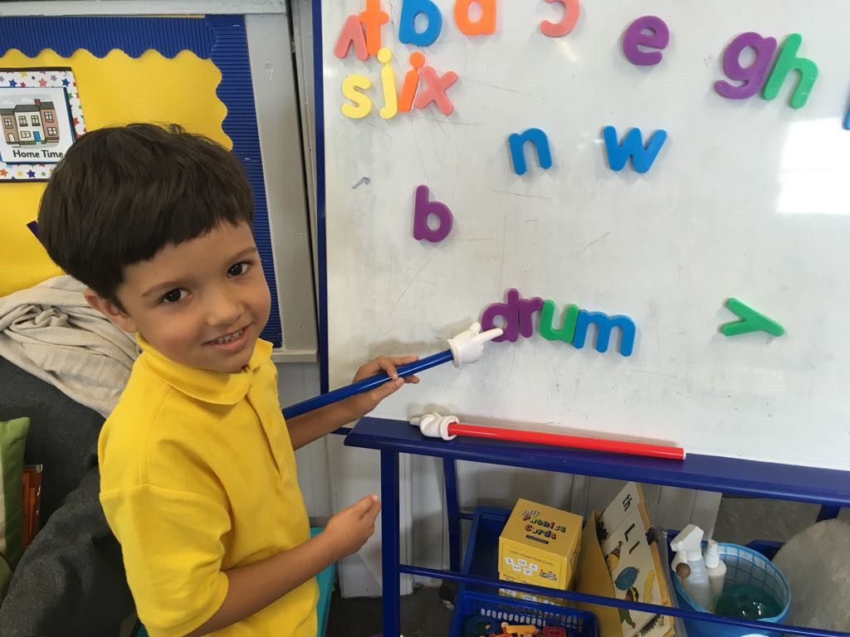

Slide 20
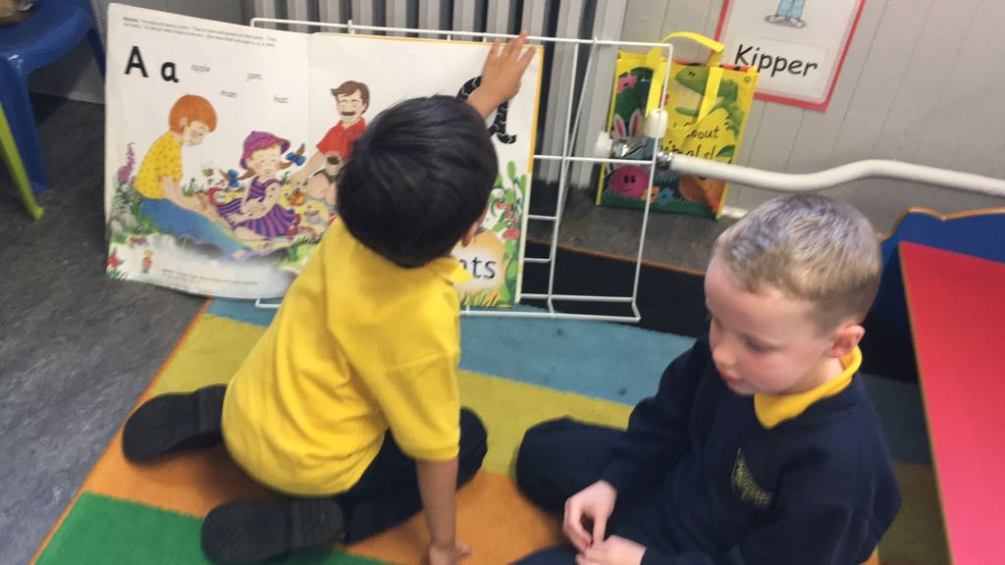

Slide 21
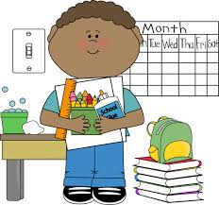
In the classroom
Mrs Robertson & Mrs Rogers talk and demonstration of
class activities.

Slide 22


GDSS
Playing with Sounds
Partnership with parents
Partnership with Parents
Margaret MacIntosh and Jane Boron

Slide 23
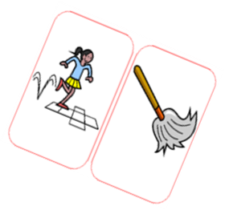

Playing With Sounds
An initiative to involve parents in playing games with children to reinforce early literacy skills including phonological awareness.

Slide 24
Word recognition
As well as using phonic skills to help with reading, the
children in Primary 1 are taught to recognise ‘character
names’ and ‘common words’
The children are given a set of flashcards featuring the character names from our reading scheme. They should learn these at home.
The children will also be given a set of flashcards of the common words to learn.

Slide 25


Oxford Reading Tree
In Primary 1 the pupils use a variety of reading materials from the Oxford Reading Tree.
The scheme is divided into stages and most children in Primary 1 will start on Stage 1.
Most of the children will be issued with a reading book after the October week.
They will have each book for about a week.
The children should be able to use their
phonic knowledge to sound out the words
in their reading books.

Slide 26
Reading books
The children should bring their reading book to school everyday.
The children will have a reading marker which we ask you to comment on.
The teacher will use the marker to provide feedback on your child’s reading.
The reading book will not be the main focus of our teaching in school.
We will focus on teaching the children the tools and skills they need in order to be successful readers.

Slide 27
Helping at home
Create a reading environment / time.
Listen to your child read or read the story to your child. Talk about the title, author, illustrator, pictures on the cover and inside the book.
Ask your child questions about the story. Try to ask a question that has the same answer as the text on the page.
Encourage your child to point to each word on the page as they read it.

Slide 28
Use magnetic letters and make some of the cvc words from the story.
Play simple games like snap with the common word flashcards to help your child learn them.
Look for the common words in their reading book.
Try playing games to help them learn the common words.
Use websites or Apps to play simple reading and phonic activities e.g. EasyLearn , Hairy Phonics
Above all try to make the experience fun.

Slide 29
Useful web sites for literacy
http://www.starfall.com – learn to read with phonics
http://www.kented.org.uk – literacy games
http://www.bbc.co.uk – literacy games ks1
http://www.oxfordowl.co.uk – helping parents
with their child’s reading at home and phonic pronunciation.

